Slide 1
presentation title
mirjam nilsson

Slide 2
agenda
INTRODUCTION 3
PRIMARY GOALS 4
AREAS OF GROWTH 5
TIMELINE 10
SUMMARY 13

Slide 3

Problem Statement
Nowadays students face a lot of problems sharing their thoughts and important updates on informal platforms, and the means at which they communicate with another to deliberate on solution has always been very difficult.
That is why there is a need for the provision of an efficient and easy way student can actually relate with each other so as to harness the strength in teaming up by solving problems.

Slide 4
Objectives
Providing students with access to high-quality study materials and resources, including interactive tutorials, practice questions, and multimedia resources, to help them master their coursework.
Supporting students in their career preparation efforts, by providing a range of resources and support for job placements, including interview guides, resume templates, and more.
Creating a strong sense of community, by offering students the opportunity to connect with their peers, engage in discussions, and collaborate on projects.
Providing students with a user-friendly interface that makes it easy to find the resources they need, when they need them.
Fostering a positive, supportive environment for students that helps to build their confidence, reduce stress and anxiety, and promote academic and professional success.
Positioning Campverse as the go-to platform for students seeking to reach their full potential, by providing industry-leading resources and support.

Slide 5
Functional Requirements
User registration and login system
Access to a wide range of study materials and resources
Career preparation resources and support
Community discussion forums
User-friendly interface
Ability to search and filter resources
Secure data storage and management

Slide 6
Non-Functional Requirements
High availability and reliability
Responsive design for use on multiple devices
Performance optimization for fast loading times
Accessibility for users with disabilities
Security and data privacy
Scalability to accommodate growing user numbers
Regular software updates and maintenance to improve functionality and security.

Slide 7
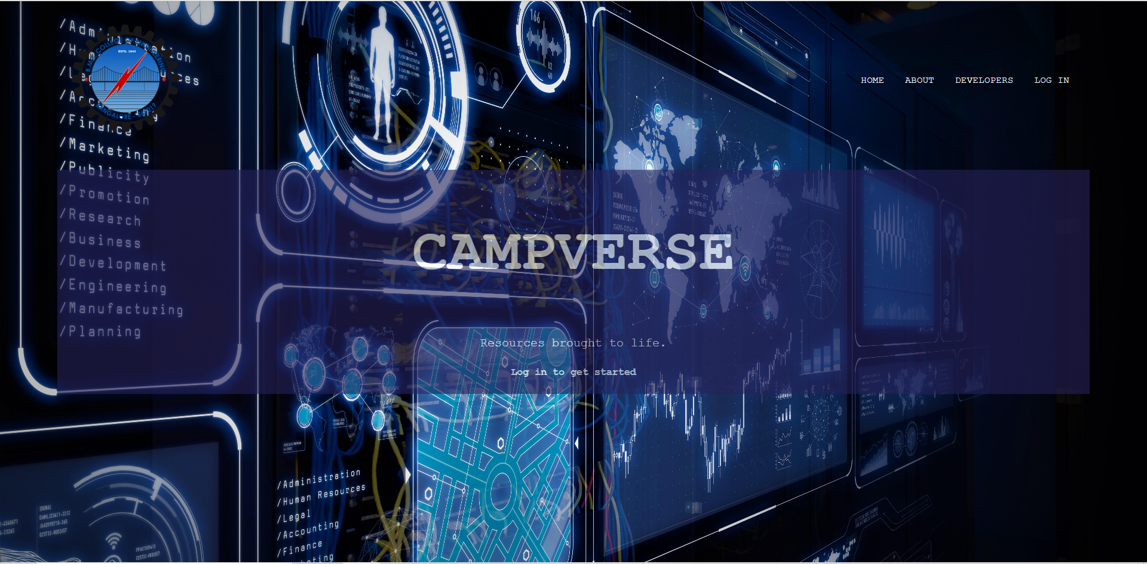
Home page

Slide 8
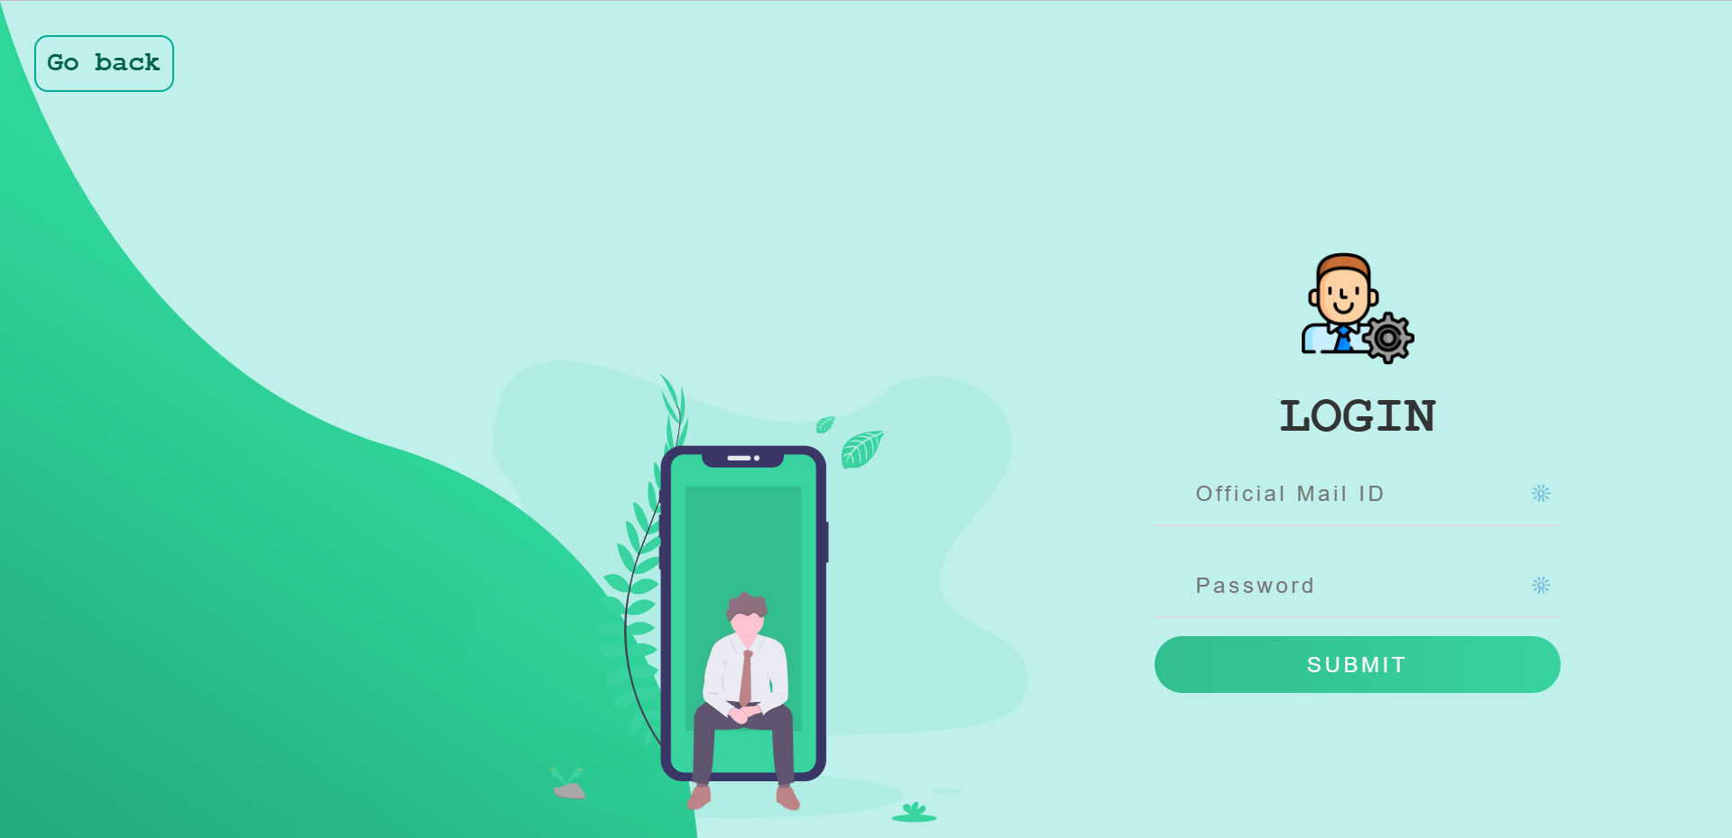
Login Page

Slide 9
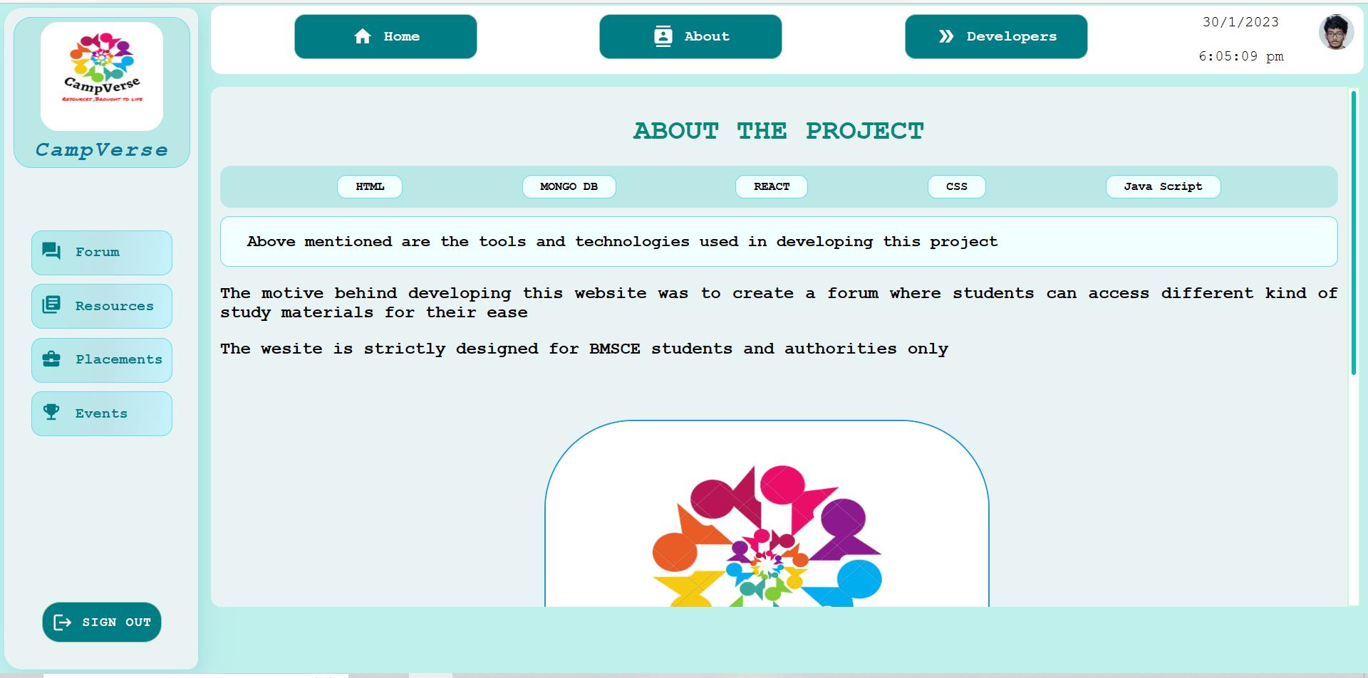
About Page

Slide 10
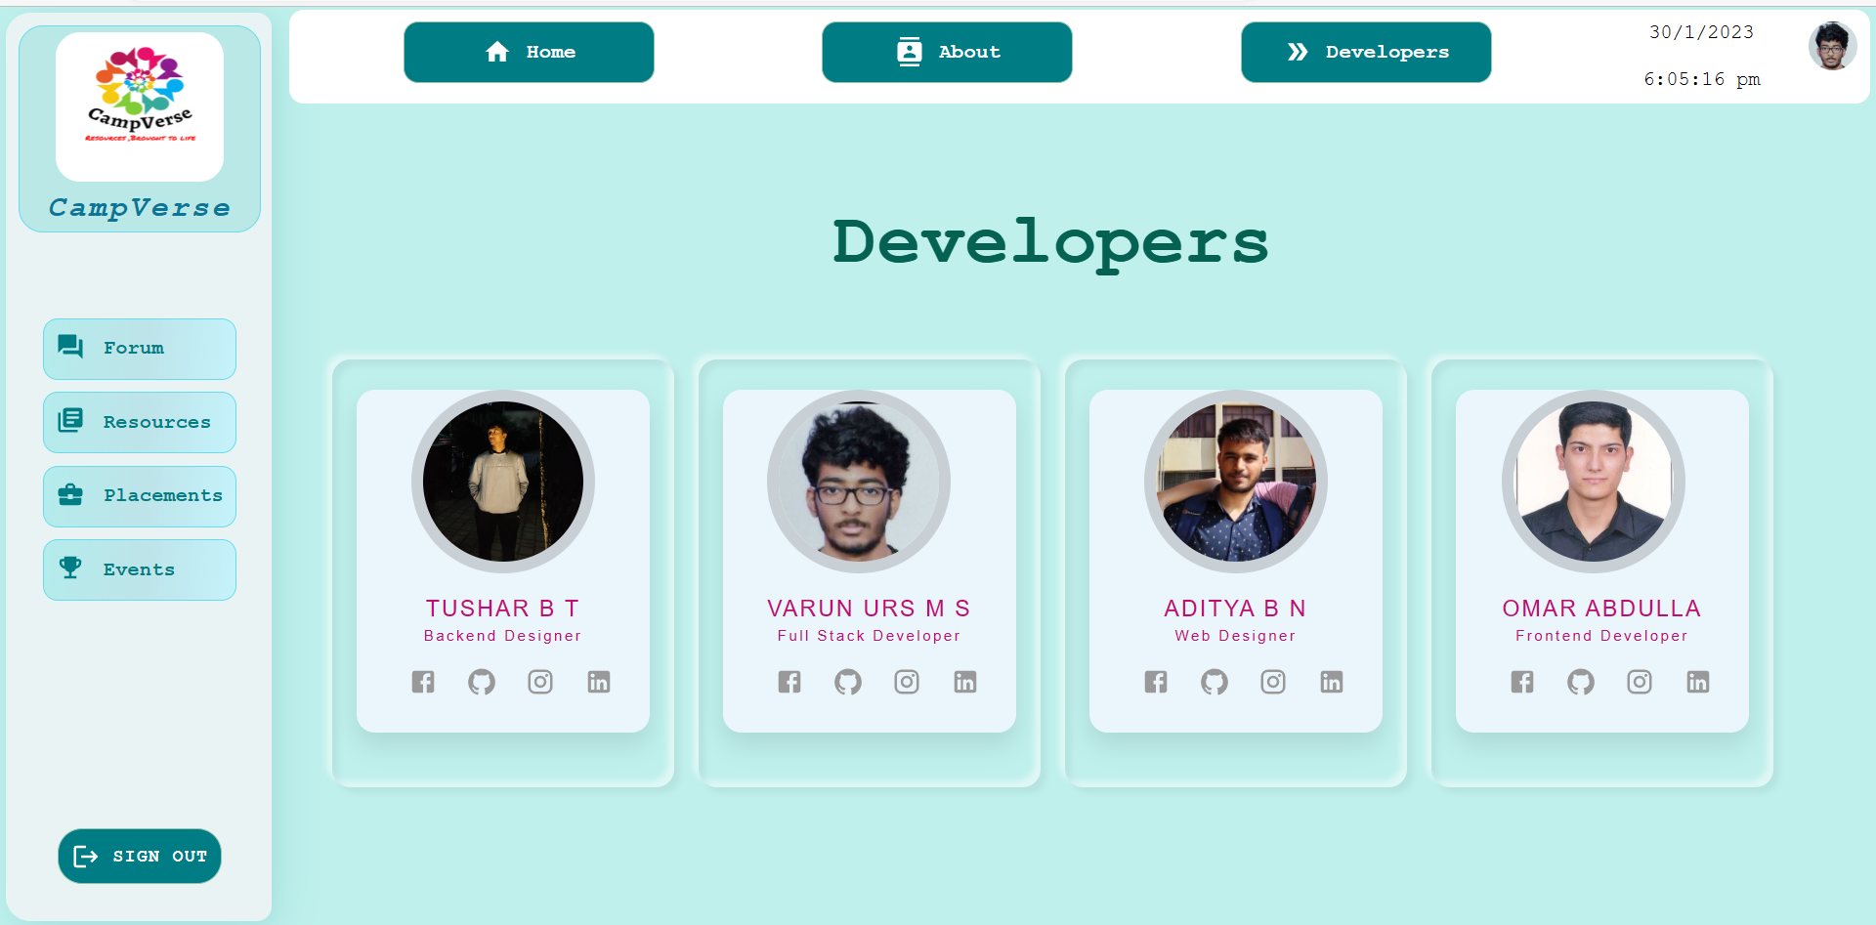
Developers Page

Slide 11
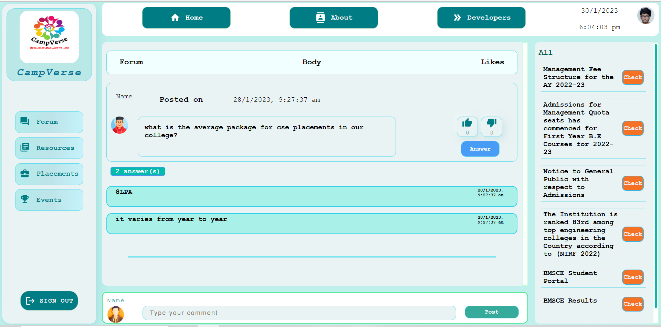
Forum Page

Slide 12
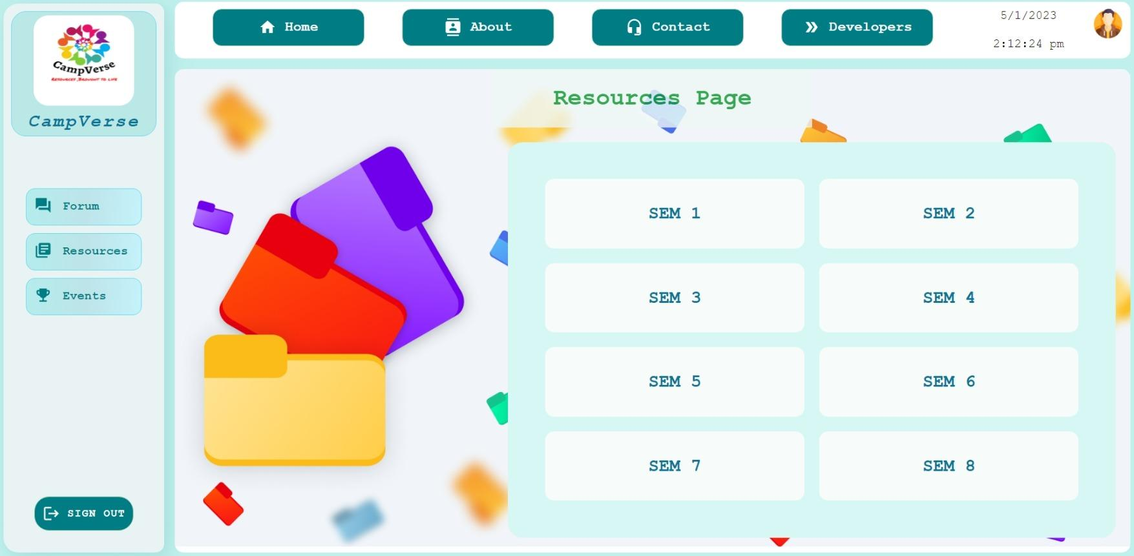
Resources page

Slide 13
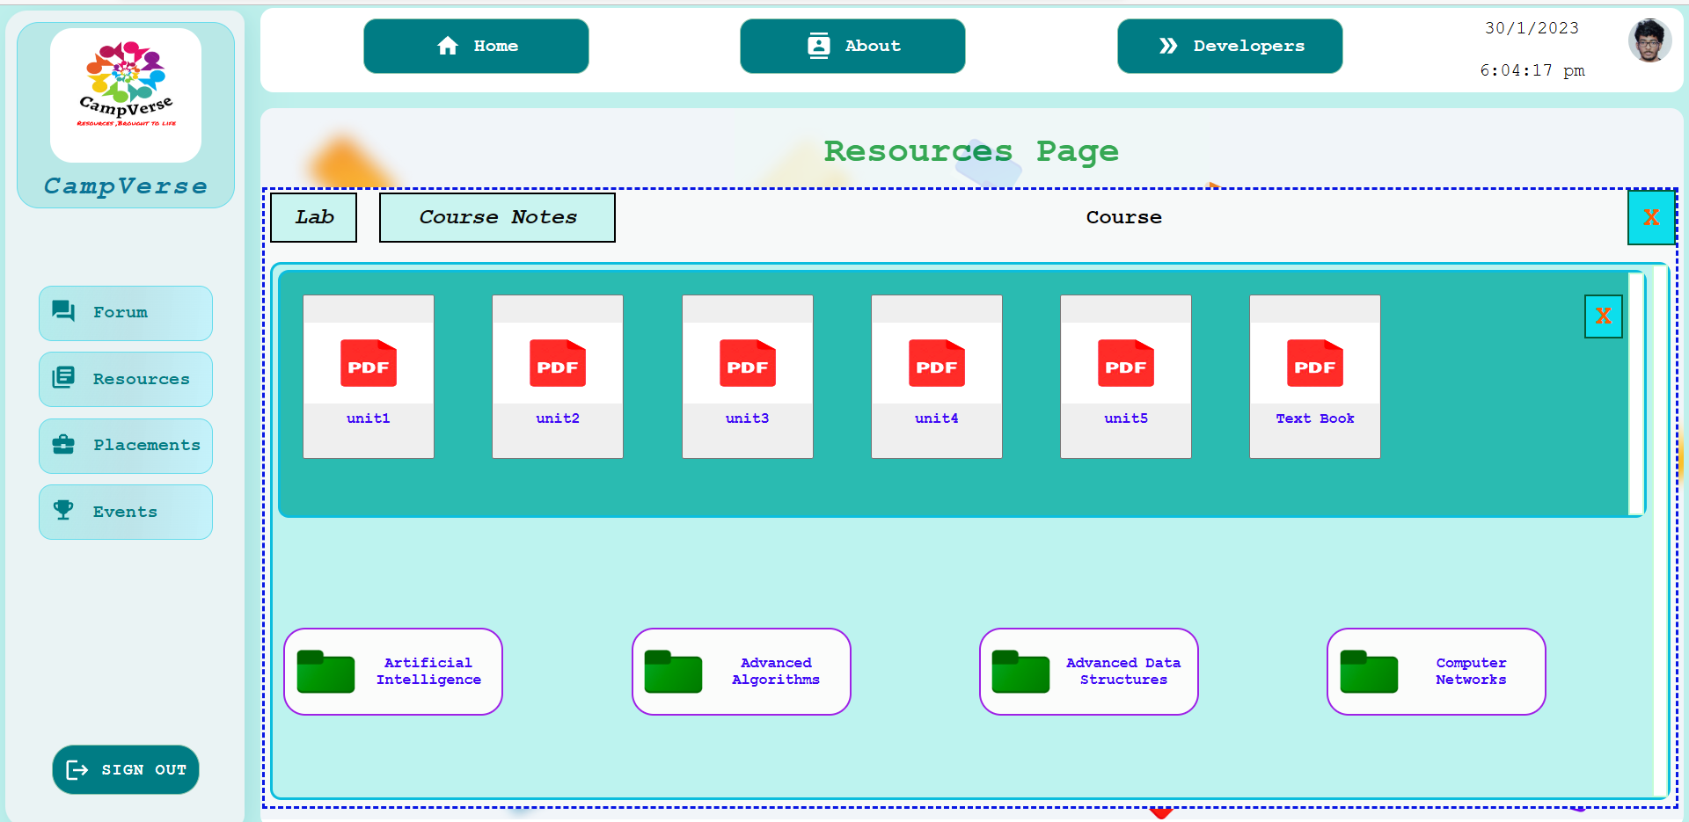
Resources page

Slide 14
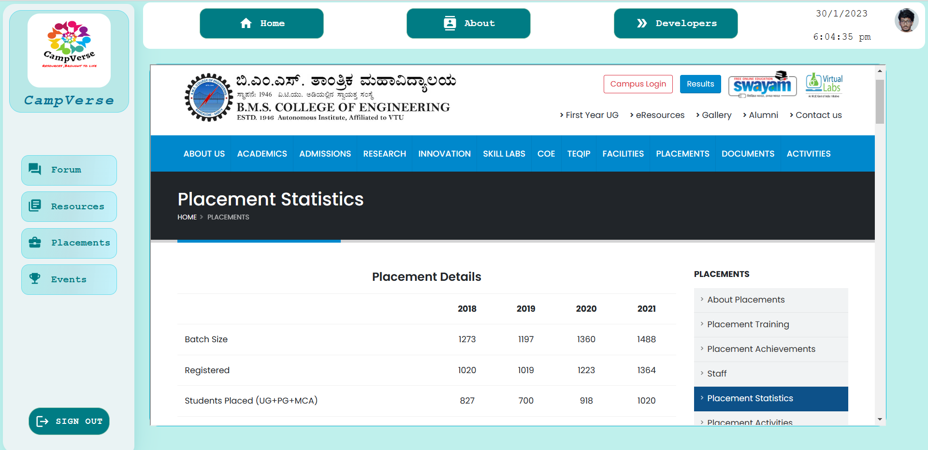
Placements Page

Slide 15
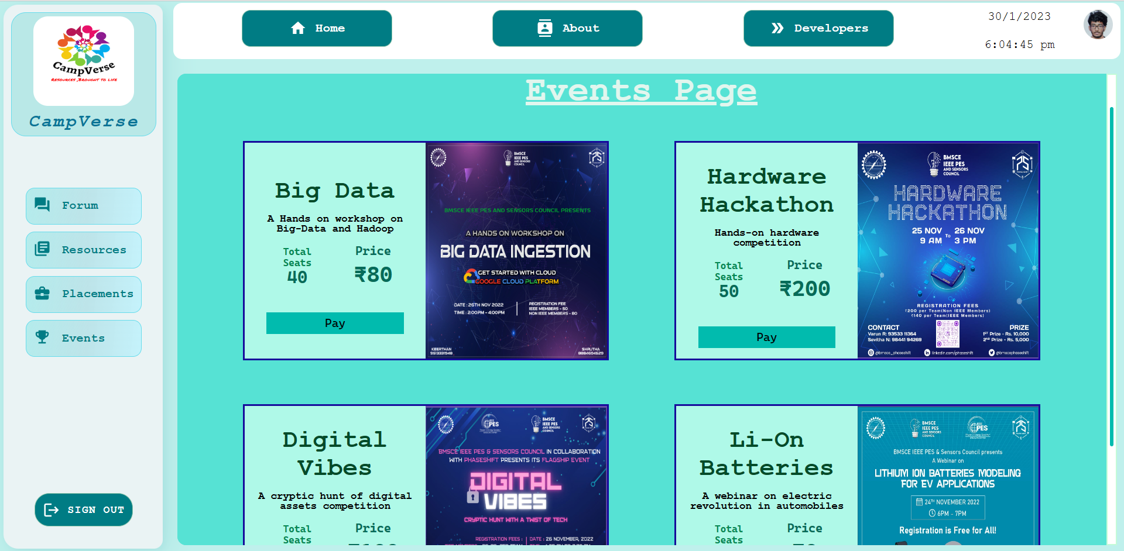
Events Page

Slide 16
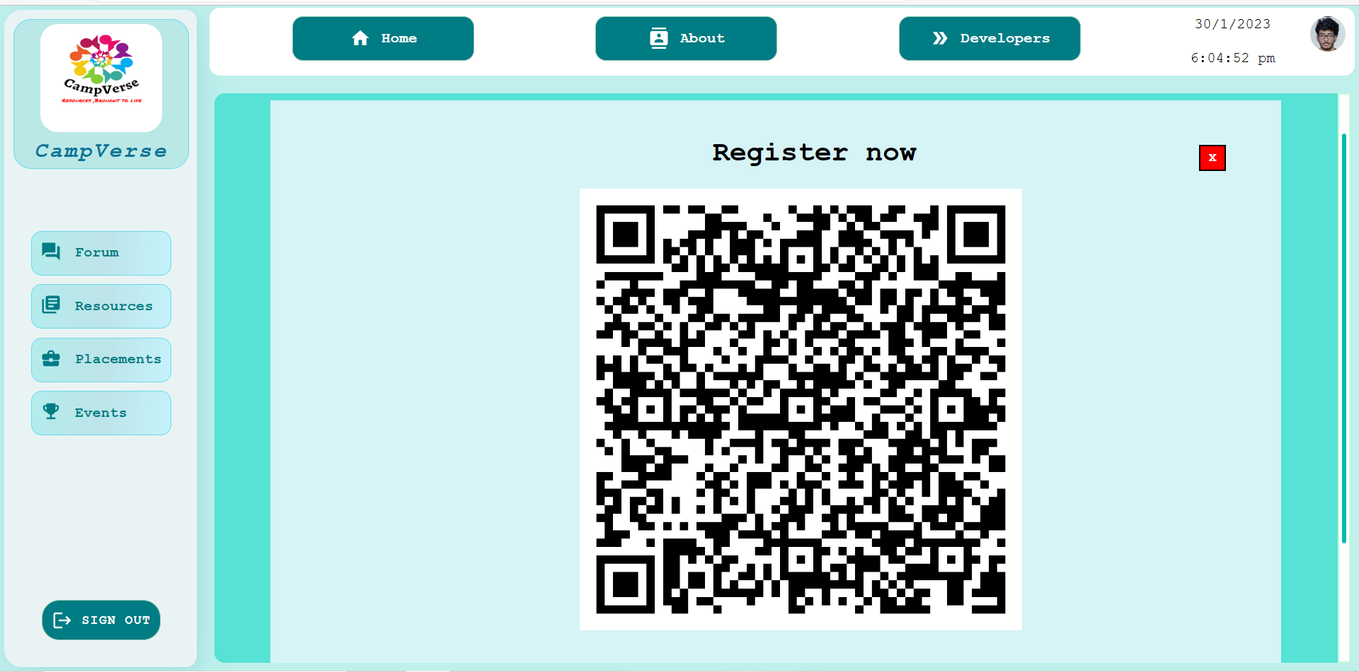
Events Page

Slide 17
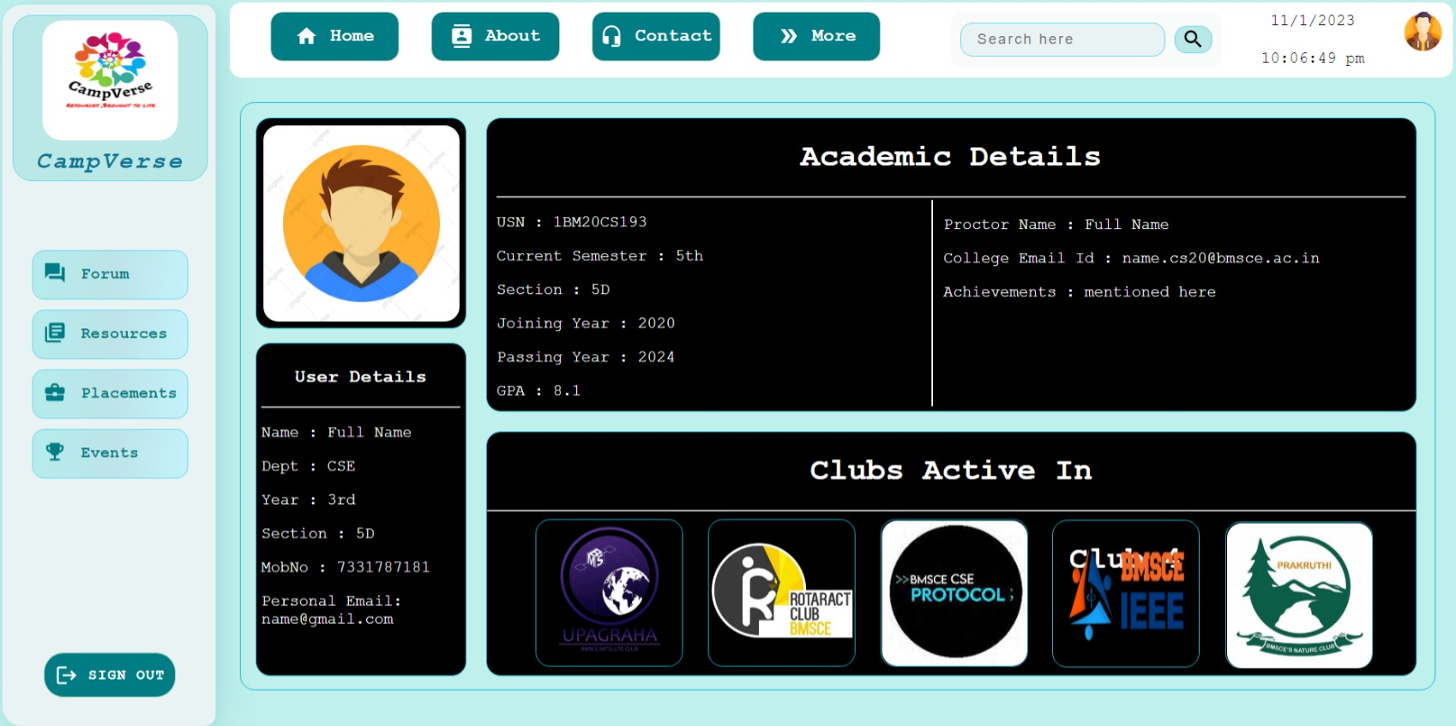
Profile Page

Slide 18
Thank you

